Slide 2
Agenda
Problem Statement
Data Description
Data Cleaning
Feature Engineering
Feature Selection
Model Development and Validation
01

Slide 3
Problem Statement
Many people struggle to get loans due to insufficient or non-existent credit histories. And, unfortunately, this population is often taken advantage of by untrustworthy lenders.
Our objective is to build a model which will help Home Credit to predict the customer’s repayment ability.
We are using a Supervised Machine Learning algorithm - Logistic Regression to build our Probability of Default(PD) model.

Slide 4
Data description
Application train – This is the main table, broken into two files for Train (with TARGET) and Test (without TARGET).
Bureau- All client's previous credits provided by other financial institutions that were reported to Credit Bureau
Bureau balance - Monthly balances of previous credits in Credit Bureau.
Credit card balance- Monthly balance snapshots of previous credit cards that the applicant has with Home Credit.
POS_cash balance-Monthly balance snapshots of previous loans that the applicant had with Home Credit.
Previous_application- All previous applications for Home Credit loans of clients who have loans in our sample.
Installments_payment - Repayment history for the previously disbursed credits in Home Credit related to the loans in our sample.
TARGET labels: 0 indicates that the person didn’t default.
1 indicates that the person defaulted.
% of 0s – 91.9%
% of 1s – 8.1%

Slide 5
Data cleaning and Feature Engineering
DATA CLEANING
For variables having 99.6% missing values, we are dropping them.
RATE_INTEREST_PRIMARY, RATE_INTEREST_PRIVILEGED, NAME_TYPE_SUITE
For variables which are very skewed to the right, which is the case in most amount variables, we have used median imputation for the missing values.
For categorical variables, we have imputed the missing values with the mode of the variable.
Other dropped variables - ‘WALLSMATERIAL_MODE’, ‘HOUSETYPE_MODE’, ‘FONDKAPREMONT_MODE’, ‘EXT_SOURCE_1’, ‘OCCUPATION_TYPE’, ‘EMERGENCYSTATE_MODE’
FEATURE ENGINEERING
INCOME_GT_CREDIT_FLAG = 1 if AMT_INCOME_TOTAL>AMT_CREDIT, 0 otherwise
CREDIT_INCOME_PERCENT = AMT_CREDIT/AMT_INCOME_TOTAL
CREDIT_TERM = AMT_CREDIT/AMT_ANNUITY
DAYS_EMPLOYED_PERCENT = DAYS_EMPLOYED/DAYS_BIRTH

Slide 6
FEATURE SELECTION
We initially had 271 variables in our data. From that, we have to select the variables which are good predictors.
We calculate Weight of Evidence and Information Value.
Then we find out the strong predictors and use them to fit our model.
For the first model, we have set a IV threshold of 0.03 and fit it using the independent variables having IV >0.03
For the second model, we took the strong predictors(IV>0.1) and variables which we felt were business intuitive with IV>0.03.

Slide 7
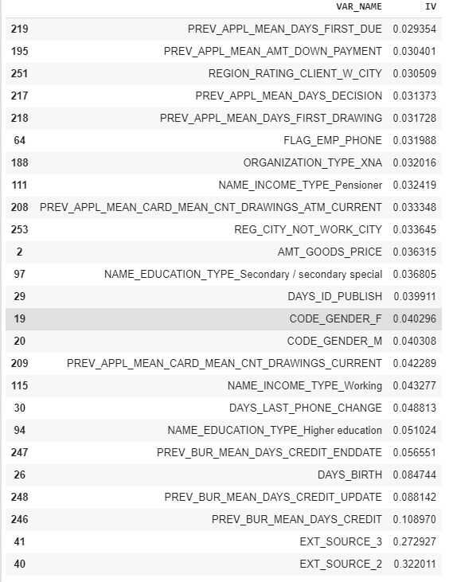
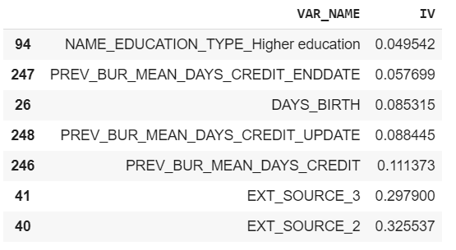
Model Development
Model 1
Features Selected – IV>0.029
Strong Predictors
Prev_Bur_Mean_Days_Credit
EXT_SOURCE_3
EXT_SOURCE_2
Model 2
Features Selected – IV>0.049(not taking Prev_Bur_Means_days_Credit_update)
Strong Predictors
Prev_Bur_Mean_Days_Credit
EXT_SOURCE_3
EXT_SOURCE_2

Slide 8
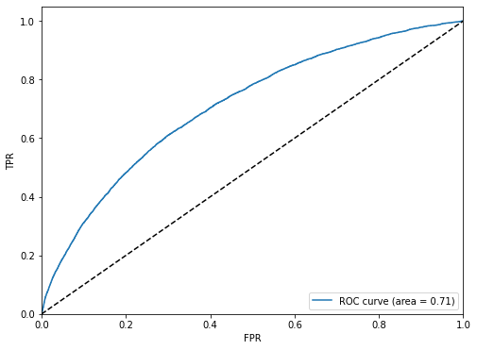
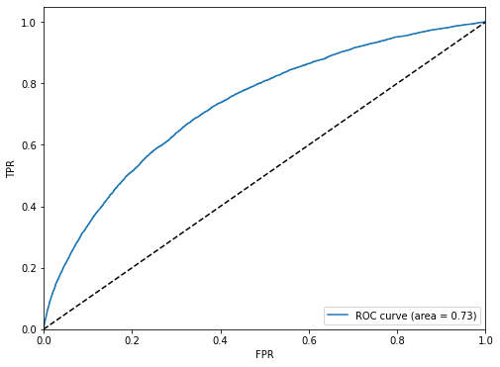
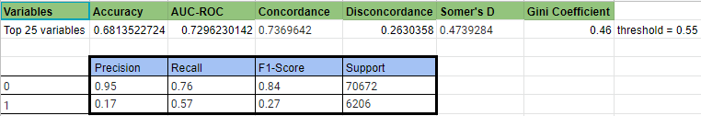
Model Validation
Model 1
Model 2

